Slide 1
MICRO IT
Report on
Tic Tac Toe Game
Submited by
Aishwarya Lokhande

Slide 2
INDEX
Topics
Page no.
1. Introduction to project 03
2. Objectives 05
3. Methodology used 06
4. Flowchart 07
5. Results and outputs 08
6. Future scope 09
7. Conclusion 10
8. Acknowledgement 11
9. References 12

Slide 3
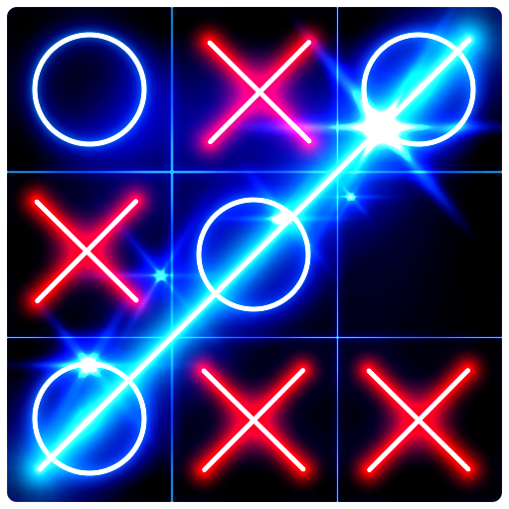
1. Introduction to Project:-
My project name is Tic -Tac -Toe game.
This game is very popular and is fairly simple by itself. It is actually a two player game. In this game, there is a board with 3x3 squares.
The goal of Tic -Tac -Toe is to be one of the players to get three same symbols in a row - horizontally, vertically or diagonally on a 3 x 3 grid.

Slide 4
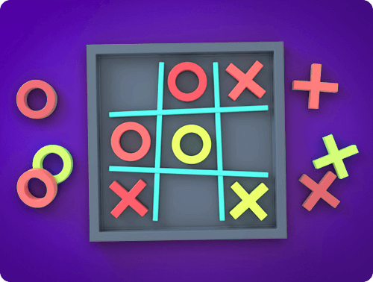
Introduction to Tic Tac Toe:-
This game uses board to control players. In each turn player enter a number and choose a move.
Simply programming assumes that player one always moves first and uses X’s. Player two moves at 2nd position and uses O’s.

Slide 5
2. Objectives:-
The game is developed for full-time entertainment and enthusiasms. It teaches the Gamer to be alert at every situation, because if the gamer is not fully alert, then that game will be lost.
Kids can also play this game, because the design of the game is very simple, controlling the game is very easy – pressing some neighboring keys of the keyboard.
This game can also be played online with our friend while sitting at home.

Slide 6
3. Methodology used:-
In this game we see (3*3)=9 square boxes.
The identifying symbol of player 1 is (X), and player 2 is (0).
When player 1 enters a number (1-9), the symbol (X) takes a position in that number.
Similarly player 2 enters his/her number, and the symbol (0) takes that position which number he/she inputs.
When a symbol (X) or (0) fully fill a column, row, or diagonal first, this symbol player will win.

Slide 7
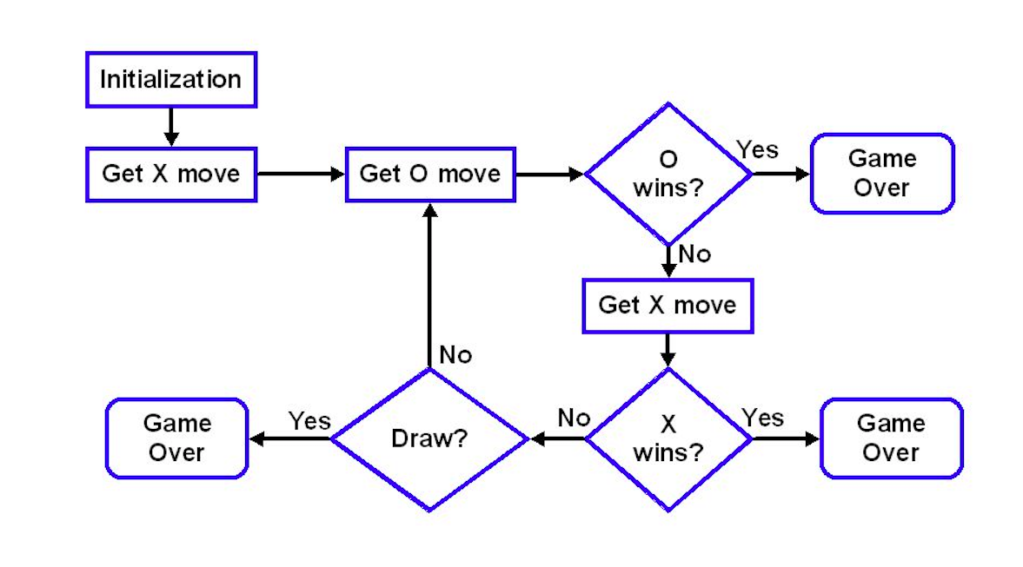
4. Flowchart:-

Slide 8
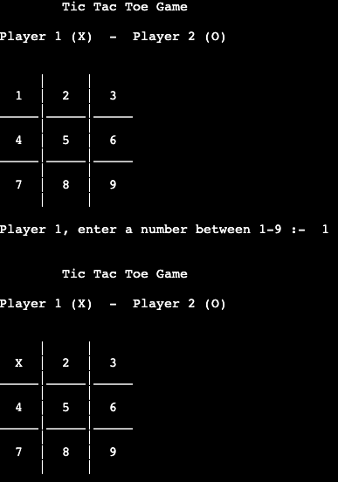
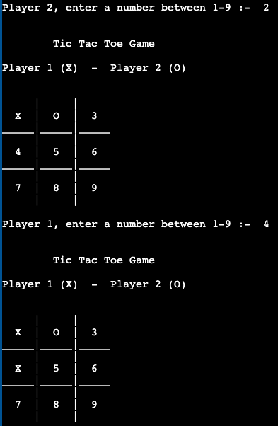
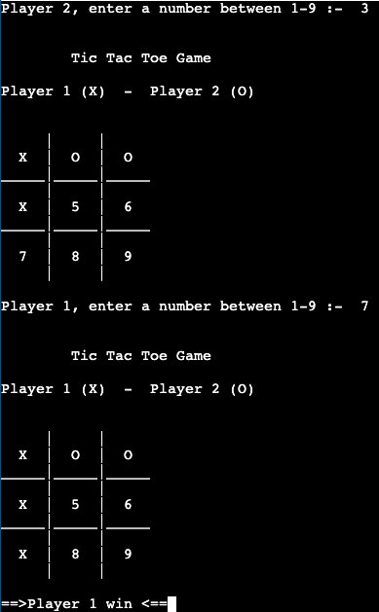
5. Results and Outputs:-
Fig:-1.1
Fig:-1.2
Fig:-1.3

Slide 9
6. Future Scope:-
Our project will be able to implement in future after making some changes and modifications as we make our project at a very low level. So the modifications that can be done in our project are:-
In future one change can be done by adding the fingerprints of the persons of which the address is entered And one more major change which can be done in this project is that to add the snaps of the person of which the address is entered.

Slide 10
7. Conclusion:-
In the conclusion of this project, I would like to say that the Tic Tac Toe game is most familiar among all the age groups and also C++ is a fun and easy programming language. While creating a project like this, it has not just been a good experience but it also helped in the development of my creativity and logical thinking. I would be more than happy to work on other projects in C++ because it’s just amazing to work with C++ programming language.

Slide 11
8. Acknowledgement:-
I would like to express my sincere gratitude to my teacher, Mr. Digvijay Puri who gave me the golden opportunity to do this wonderful project, which also helped me in doing a lot of Research and i came to know about so many new things I am really thankful to them. Secondly i would also like to thank my parents and friends who helped me a lot in finalizing this project within the limited time frame.

Slide 12
9. References:-
Google search images :-
https://www.google.com/search?q=tic+tac+toe+game
https://www.google.com/search? tic tac+toe+game+flowchart,g_1:c%2B%2B:
Geeks for Geeks:-
https://www.geeksforgeeks.org
You tube Videos:-
https://www.youtube.com/watch?v=69lxVMY5610&t=3s
https://www.youtube.com/watch?v=KrH1qNVYKO0&t=30s
GitHub Gist:-
https://gist.github.com

Slide 13


